Slide 1
Class of 2023 Senior Parent Night

Slide 2
Introductions
Melee Vander Velde - Counselor A-K
Sarah Thorson – Counselor L-Z
Sarah Brooks – College and Career Counselor

Slide 3
Agenda
IMPORTANT DATES
GRADUATION REQUIREMENTS
POST-GRADUATION PLANNING
4-YEAR COLLEGES
COLLEGE AND CAREER UPDATES
FINANCIAL AID
LETTER OF RECOMMENDATION PROCEDURES

Slide 4
Senior Year can be overwhelming
A lot of work still needs to be done both inside and outside the classroom to reach your goals.
Senior Stressors:
Deadlines for college applications, tests, assignments, scholarship applications…
Meeting graduation requirements
Maintaining your GPA
Navigating plans for your future
Money…scholarships…FAFSA…!!!
BLOOD PRESSURE SPIKING!

Slide 5
RELAX!!!
We’re here to support you.
Helping you communicate with teachers
Problem-solve tech issues
Credit Checks
College/Technical school applications support
High School and Beyond plan
FAFSA help
Letters of Recommendation
Social/emotional support
Chocolate when necessary

Slide 6
Organization is Key
Important Dates:
Please refer to the Important Dates For 2023 Seniors handout as a roadmap for this year

Slide 7
How do I keep up with all these important events?
Sequim High School Main Website
Counseling Webpage http://shs.sequimschools.org/our_school/counseling
Career Center Webpage – Important Updates coming soon!
SKYWARD
Monitor your student’s grades and graduation status
CANVAS and Microsoft Office Teams
Make sure we have your most up-to-date home address, email address and phone numbers to ensure clear lines of communication
Friday Newsletters, Daily Bulletins
Check your email school, personal and home

Slide 8
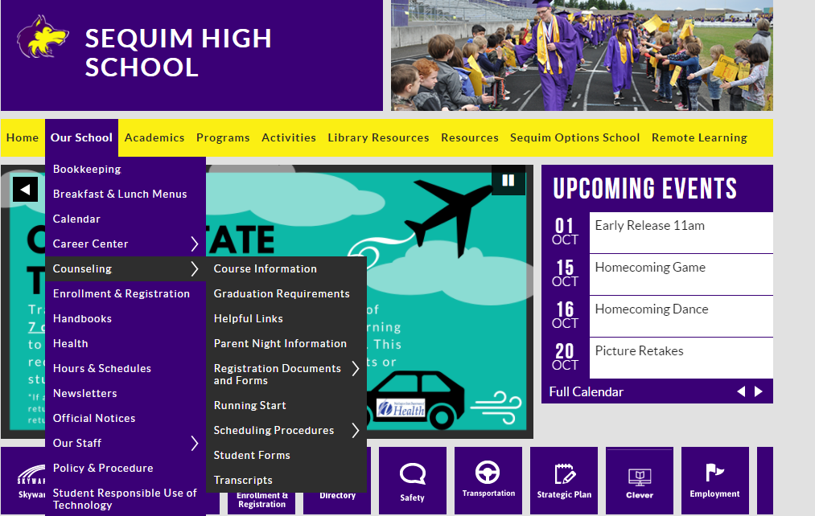
#1
#2

Slide 9
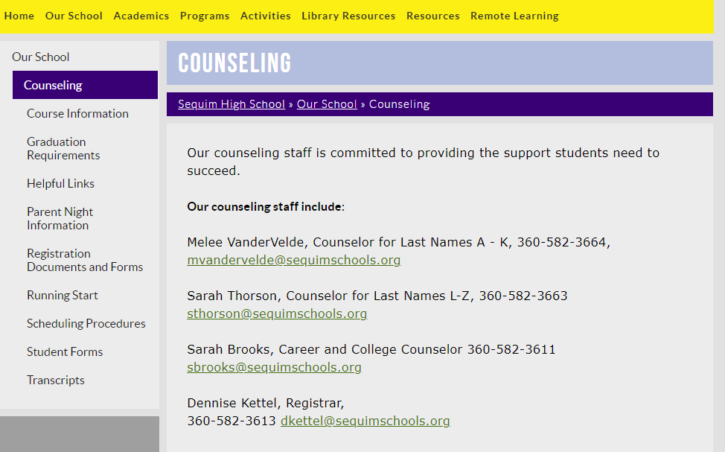
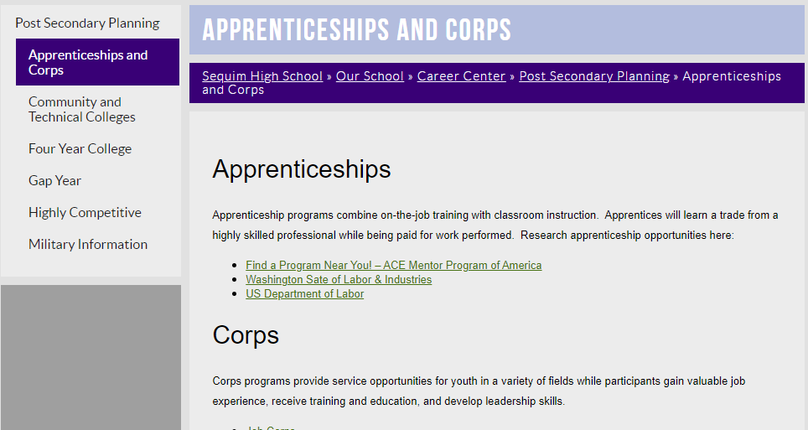
Career Center Webpage
Counseling Webpage
UNDERCONSTRUCTION! MORE UPDATES COMING SOON!

Slide 10
Avoid the dreaded Senioritis
Seniors must pass their required classes for High School graduation.
Colleges look at senior grades when they are making their final decisions on future students.
Some colleges will request mid-year reports at the end of first semester and all colleges request final transcripts
A college may withdraw an offer of admission when grades drop significantly over the course of the senior year OR if a student drops certain course during the second semester.

Slide 11
Graduation Requirements
Earn 24 credits in specific subjects
English 4.0
Math 3.0
History 3.5*
Science 3.0
PE/Health 2.0
World Language 2.0*
Art 2.0*
CTE 1.0
Microsoft Academy 0.5
Elective 3.0
Other Requirements:
Complete Senior HIV/STD Awareness Training
Complete a High School and Beyond plan
Complete Graduation Pathways requirement

Slide 12
Graduation Requirements (cont.)
High school and Beyond Plan:
We have transitioned to a digital plan
You will be completing this plan with the assistance of your DEN class
The digital plan also gives you access to college and career exploration tools
Graduation Pathways:
There are multiple ways to achieve this requirement. One way to complete this is by passing your SBA in English and Math.
You will work in HSBP and with counselors to ensure Graduation Pathway aligns with the post-secondary goals indicated in your High School and Beyond Plan.

Slide 13
We are here to help!
Fall Graduation Progress Check Letter
Mailed home in November
Spring Graduation Progress Check Letter
Mailed home in March
You can also check Skyward anytime to review your progress in meeting graduation requirements

Slide 14
I’m on track to earn my diploma…but what about after graduation?
2- or 4-year College/University
Career Training/Technical School
Military
Join the Work Force / Apprenticeship
“Gap” Year
“I have absolutely no clue!”

Slide 15
Things to consider:
2-year colleges offer a variety of technical and associate degrees, in addition to transfer requirements for 4-year colleges.
4-year colleges offer a variety of bachelor, masters and doctorate degree options and have varying admission requirements and deadlines – check with the colleges you are interested in attending early and often
Career Training/Technical Schools have varying admission requirements, so it’s important to contact individual schools
Military branch enlistment requires the Armed Services Vocational Aptitude Battery (ASVAB) which will be offered at SHS in December and March…more information to follow
The work force often offers salary/position advancement through additional training and education, check with your employer to see what opportunities are available
Gap years can provide invaluable experiences to provide focus and clarity, but they can also turn into gap decades without a plan

Slide 16
There is no wrong path, but there is a right path for you

Slide 17
Additional education is the path for me!
What should I do now?

Slide 18
College and Career Search Tools
www.bigfuture.collegeboard.org
https://compass.wsac.wa.gov/?utm_medium=email&utm_source=govdelivery
Planning for life after high school? Check out Washington’s new College & Career Compass:
Explore educational programs that match your career interests.
Learn more about the value of college and how financial aid can help you pay for a certificate, apprenticeship, or degree.
Connect with a campus to get additional support.
Stay motivated, get ready, and focus on the future. College & Career Compass makes it easy. Learn more at compass.wa.gov.
https://www.careerbridge.wa.gov/
Lost? Need help? Have questions? Not sure where to start? Book an appointment with Mrs. Brooks to talk about your options after high school.

Slide 19
College and Career Representatives
Upcoming College and Career Visits on Career Center website Calendar
October 6th – Eastern Washington University
October 12th – College and Career Mini Fair
October 13th - Gonzaga University
October 17th – Central Washington University
October 20th – Whitworth University
November 4th – National College Fair in Seattle
What should I say to a College or Career Rep?

Slide 20
Important test reminder for 4-year schools
Many University and College admissions are now test blind, test optional or test not required. These tests are still a strong data point for schools so in many situations it is still recommended students take it.
You must register for ACT and SAT through their websites
To sign up for the ACT, please go to www.act.org
To sign up for the SAT, please go to https://collegereadiness.collegeboard.org/sat
REMEMBER, official test scores must be sent by College Board (SAT) or ACT directly
Check with your college admissions office to see what, if any, specific tests are required.

Slide 21
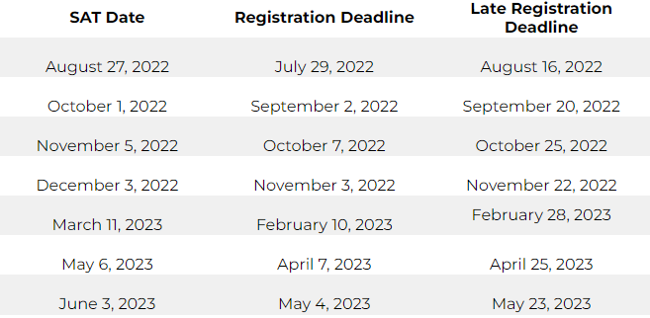
Testing Dates for 2022-2023

Slide 22
College Applications
Students must check with each college individually as requirements vary by institution
Many colleges accept the Common Application or the Coalition Application
Admission Applications must be submitted to be considered for financial aid
If you have any questions about college applications, contact Mrs. Brooks - sbrooks@sequimschools.org
Check and re-check deadlines!
We are offering open office hours in SHS Library if you need assistance

Slide 23
Remember
Colleges, universities, and technical schools all differ significantly in minimum requirements
It’s important to know what your school is looking for and what deadlines they have for specific information.
Review college admissions websites early and often.
Remember to look at application and Financial Aid deadlines for each institution, as the dates will differ.
Ask for help if you need it…THAT’S WHAT WE’RE HERE FOR!

Slide 24
Guaranteed Admissions Program
Sequim High School is participating in a partnership with 5 WA state Universities (Central Washington University, Eastern Washington University, Evergreen State, Washington State University and Western Washington University) to provide guaranteed admission to students who meet the below qualifications:
Participating institutions require two criteria be met for a student to be eligible for guaranteed admissions: (1) A cumulative GPA of 3.0 or higher and (2) Completion of the College Academic Distribution Requirements (CADRs). If a student meets the criteria or is on track to meet the criteria by high school completion, he/she/they are guaranteed admission to the institution.

Slide 25
Financial Aid Options
One of the most common mistakes students make is to avoid applying to colleges or technical schools simply because they believe they cannot pay for it. Please note that many students will qualify for at least one of the following types of financial aid:
GRANTS:
Money provided by the state or paid by the Federal Government that does not have to be repaid.
LOANS
Money that must eventually be repaid. Often with a low interest or deferred interest plan.
SCHOLARSHIPS
Money awarded for need, talent or merit.
Can be local or national
WORK STUDY
Paid college campus employment
WESTERN UNDERGRADUATE EXCHANGE PROGRAM
Tuition and a half for out-of-state participating institutions

Slide 26
FAFSA or WASFA
The FAFSA application opens October 1st
Check in with the school to which you are applying to determine their priority deadline for submitting FAFSA
Get your FAFSA ID early at https://studentaid.gov/
Washington College Access Network is providing several virtual FAFSA webinars to assist parents and students in English and Spanish

Slide 28
Class of 2023 Scholarship Notebooks
Interested seniors will design a digital scholarship notebook.
An email will be sent in October with a reminder of the Scholarship Notebook Workshop on Monday, November 21st at 6PM. WATCH YOUR EMAIL!
Instructions, application materials, and helpful videos will be available on the Career Center Web Site. This is your MAIN resource — use it!
You MUST read ALL instructions and watch ALL instructional videos on the Career Center website before you begin to create and submit your scholarship notebook. This is a time and frustration saver.
You can contact Mrs. Brooks for sbrooks@sequimschools.org questions/information/help
The scholarship notebooks will be due on February 21, 2023 by 3PM. No late books can be accepted!

Slide 29
Other Scholarship Sources
FAFSA and WAFSA
Financial Aid Calculator - https://studentaid.gov/aid-estimator/
Career Center Scholarships – Check the SCHOLARSHIP WATCH list on the Career Canter website for updates
Colleges / Universities
Affiliations
Online clearinghouses:
The Washboard – https://washboard.wsac.wa.gov/login.aspx
Scholarships.com - https://www.scholarships.com/
College Bound Scholarship
Military

Slide 30
Letters of Recommendation
WHY DO YOU NEED THEM?
College Applications
Scholarship Notebook/Applications
Jobs
HELPFUL HINTS
Use our Letter of Recommendation Information Sheet
Make sure to give your “Recommenders” plenty of time
Send Thank You notes to those who have written letters for you
Where can I find this?
http://shs.sequimschools.org/our_school/career_center/scholarship_notebook

Slide 31
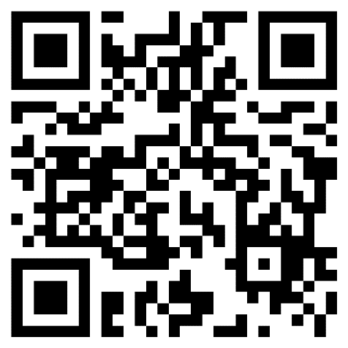
QUESTIONS?
Please fill out this quick survey using the QR code! Thank you for coming!
Counselor Contacts
Melee Vander Velde – mvandervelde@sequimschools.org
Sarah Thorson – sthorson@sequimschools.org
Sarah Brooks – sbrooks@sequimschools.org

